Slide 1
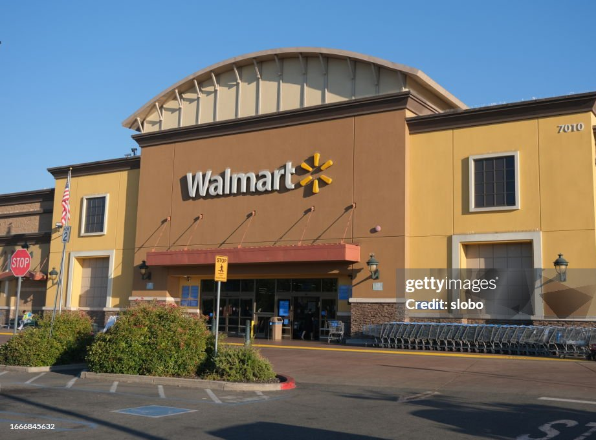
Sales Performance Analysis of Walmart Stores
Using Advanced MySQL Techniques
BY- Bulbul Singh

Slide 2


Introduction
Walmart, operating across multiple cities and product categories, faces challenges in understanding sales trends, customer preferences, and operational efficiency. This project analyzes the Walmart Sales Dataset (~1,000 transactions, 18 attributes) to address these challenges by uncovering key patterns in revenue, customer behavior, and product performance.
Using MySQL Workbench, I applied aggregation, window functions, ranking, segmentation, and time-series analysis to deliver actionable insights aimed at boosting sales growth, improving customer retention, and optimizing inventory.
Tools: MySQL Workbench, Excel, power BI PowerPoint

Slide 3
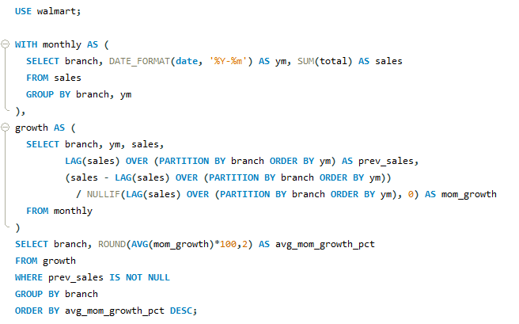
Task 1 – Top Branch by Average month-over-month Sales Growth Rate
Result
SQL Query
BUSINESS PROBLEM
Branch | Avg_MOM_Growth_pct
B | 17.98
C | 5.96
A | -3.28
Walmart wants to identify which branch is growing the fastest month-over-month to allocate marketing budgets and operational resources effectively.
Insight
Branch B shows the highest average MoM sales growth, making it the best candidate for increased promotional investment.
OBJECTIVE
Find the branch with the highest average month-over-month (MoM) sales growth.
Approach
Grouped sales by branch & month.
Calculated month-over-month % growth using LAG().
Averaged growth per branch & ranked.

Slide 4
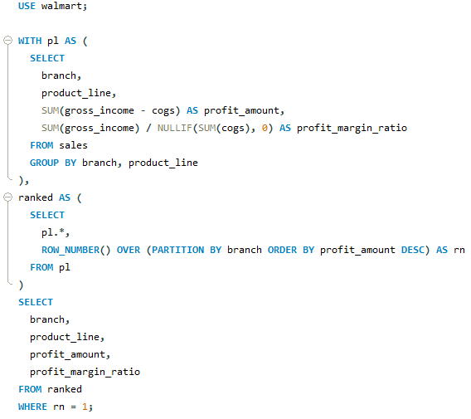
Task 2 – Most Profitable Product Line for Each Branch
SQL Query
Result
BUSINESS PROBLEM
Branch | Product_Line | Profit_Amount | Profit_Margin_Ratio
A | Health and beauty | -11397.967 | 0.05
B | Food and beverages | -13765.8515 | 0.05
C | Home and lifestyle | -12572.167 | 0.05
Walmart wants to identify the most profitable product line in each branch to focus on stocking, marketing, and improving sales in the highest-margin categories.
Insight
Profitability varies by branch — tailored strategies will outperform one-size-fits-all approaches.
OBJECTIVE
Find the product line in each branch that generates the highest profit (Gross Income – COGS).
Approach
Calculated profit (gross_income - cogs) per branch & product line, ranked them using ROW_NUMBER(), and selected the top product line for each branch.

Slide 5
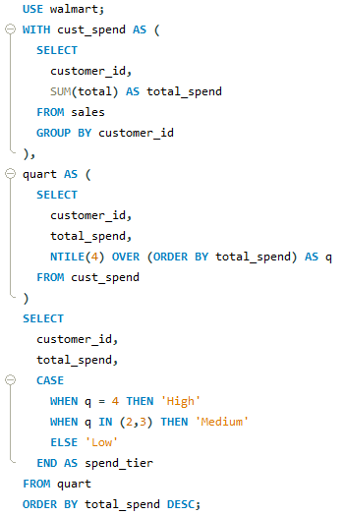
Task 3 – Customer Segmentation by Spending Tiers
Result
SQL Query
BUSINESS PROBLEM
Row Labels | Count of Customer_id
High | 3
Low | 4
Medium | 8
Grand Total | 15
Walmart needs to identify customer segments based on spending behavior to design targeted promotions, loyalty programs, and personalized offers.
Insight
Most customers fall into the Medium tier, showing balanced spending behavior. High spenders should be prioritized for premium offers, while Low spenders may need incentives to increase purchase frequency.
OBJECTIVE
Classify customers into High, Medium, and Low spenders based on total spend and analyze the count in each group.
Approach
Calculated each customer’s total spend, divided them into quartiles using NTILE(4), assigned spend tiers (High, Medium, Low), and counted customers in each tier.

Slide 6
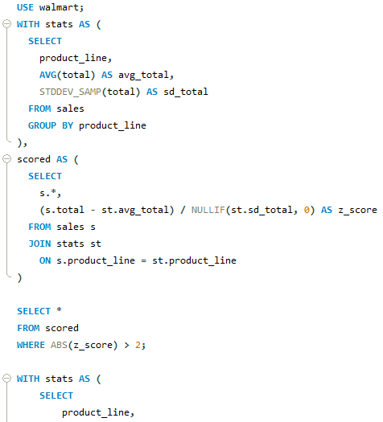
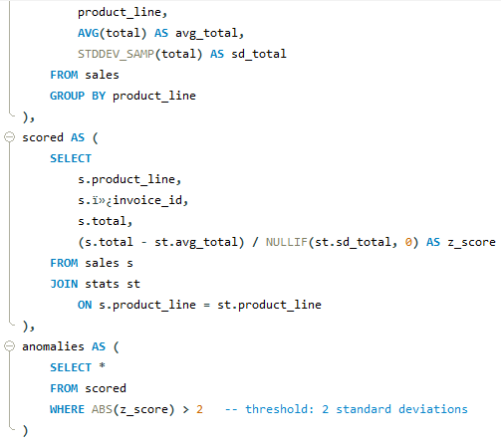
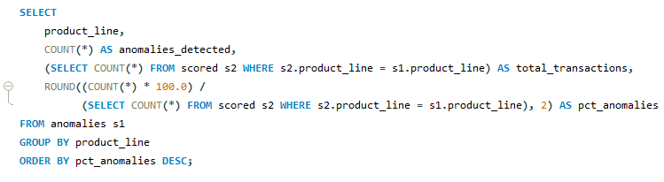
Task 4 – Detecting Anomalies in Sales Transactions
SQL Query
BUSINESS PROBLEM
Walmart suspects that certain sales transactions are unusually high or low compared to the average for each product line. Detecting these anomalies will help identify possible errors, fraud, or exceptional cases that need further investigation.
OBJECTIVE
Identify sales transactions that significantly deviate from the average sales of their respective product line.

Slide 7
Task-4 Result
Approach
Calculated average sales and standard deviation per product line.
Computed Z-scores for each transaction.
Flagged anomalies where sales significantly deviated from the product line average.
Summarized anomalies by product line (% anomalies vs total transactions).
Insight
Food and Beverages had the highest anomaly count, suggesting irregular transaction behavior.
Fashion Accessories and Electronics showed fewer anomalies, indicating more stable sales patterns.
Overall anomaly percentage is low, but detecting these ensures better fraud detection and operational monitoring
Product_line | Anomalies_detected | Total_transactions | % of anomalies
Food and beverages | 12 | 174 | 6.9
Electronic accessories | 9 | 170 | 5.29
Fashion accessories | 9 | 178 | 5.06
Sports and travel | 8 | 166 | 4.82
Health and beauty | 7 | 152 | 4.61
Home and lifestyle | 6 | 160 | 3.75

Slide 8
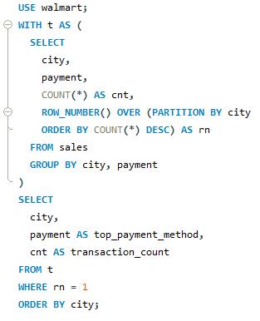
Task 5 – Most Popular Payment Method by City
Result
SQL Query
BUSINESS PROBLEM
City | Top_payment_method | Transaction_count
Mandalay | Ewallet | 113
Naypyitaw | Cash | 124
Yangon | Ewallet | 126
Walmart wants to know which payment method (Cash, Credit Card, or E-wallet) is most preferred in each city. This helps tailor marketing strategies and partnerships with financial/payment providers..
Insight
Payment preferences differ by city: e.g., Yangon customers prefer E-wallets, Mandalay favors Cash, and Naypyitaw prefers Credit cards. Walmart should customize promotions and partnerships based on city-specific payment trends.
OBJECTIVE
Identify the most popular payment method in each city based on transaction count.
Approach
Counted transactions per payment method in each city, ranked them using ROW_NUMBER(), and selected the top method per city.

Slide 9
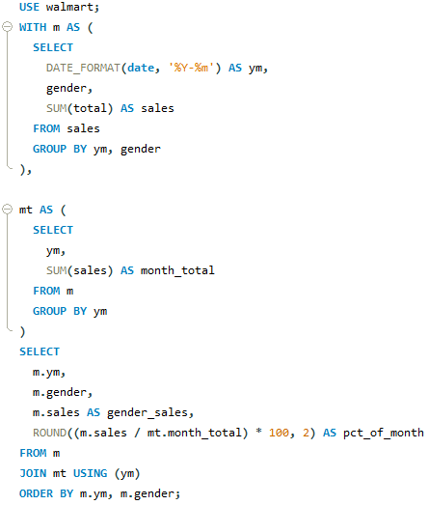
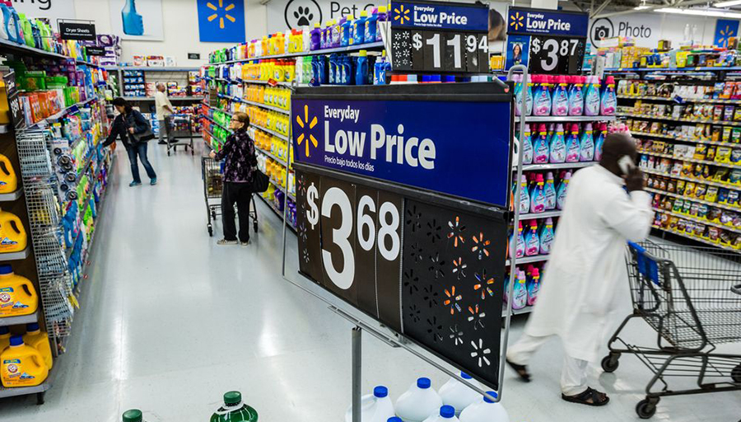
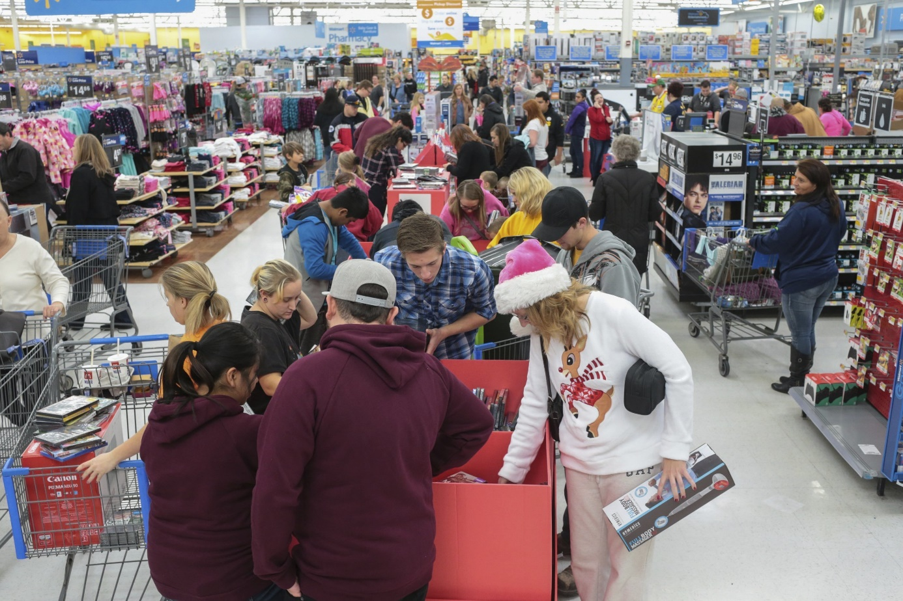
Task 6: Monthly Sales Distribution by Gender
SQL Query
BUSINESS PROBLEM
Approach
Grouped sales by month and gender, calculated total sales, and compared distribution between male and female customers.
Walmart wants to analyze how male and female customers contribute to monthly sales. This helps in understanding gender-based buying patterns and tailoring promotions accordingly.
OBJECTIVE
Compare monthly sales distribution between male and female customers.

Slide 10
Task-6 Result
Year-Month | Gender | Gender_sales | % of Month
2019-01 | Female | 6398 | 65
2019-01 | Male | 3426 | 35
2019-02 | Female | 7477 | 59
2019-02 | Male | 5170 | 41
2019-03 | Female | 5794 | 47
2019-03 | Male | 6606 | 53
2019-04 | Female | 5491 | 69
2019-04 | Male | 2467 | 31
2019-05 | Female | 9192 | 72
2019-05 | Male | 3607 | 28
2019-06 | Female | 3290 | 34
2019-06 | Male | 6322 | 66
2019-07 | Female | 5309 | 46
2019-07 | Male | 6192 | 54
2019-08 | Female | 9795 | 73
2019-08 | Male | 3708 | 27
2019-09 | Female | 6414 | 47
2019-09 | Male | 7353 | 53
2019-10 | Female | 5433 | 55
2019-10 | Male | 4432 | 45
2019-11 | Female | 5594 | 58
2019-11 | Male | 4024 | 42
2019-12 | Female | 4505 | 38
2019-12 | Male | 7356 | 62
Insight
Female customers generally contributed slightly higher sales than males across months.
Seasonal peaks were observed in both genders, but females consistently outperformed in total sales.
Indicates that female-oriented promotions may drive more revenue.

Slide 11
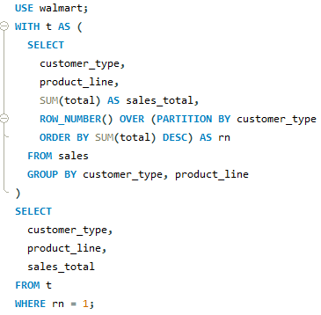
Task 7 – Best Product Line by Customer Type
Result
SQL Query
BUSINESS PROBLEM
customer_type | product_line | sales_total
Member | Food and beverages | 31358
Normal | Electronic accessories | 29839
Walmart wants to understand which product lines are most preferred by different customer types (Member vs Normal) so that marketing campaigns and loyalty programs can be targeted more effectively.
Insight
Members prefer Food & Beverages, while Normal customers prefer Electronic Accessories. Promotions should target these preferences.
OBJECTIVE
Identify the most popular product line for each customer type (Member, Normal) based on sales.
Approach
Grouped sales by customer type and product line, calculated total sales, ranked product lines for each type, and identified the top product line preference for Members and Normal customers.

Slide 12
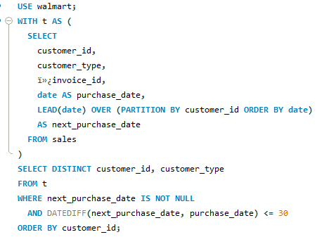
Task 8 – Identifying Repeat Customers
Result
BUSINESS PROBLEM
customer_id | customer_type
1 | Member
1 | Normal
2 | Member
2 | Normal
3 | Member
3 | Normal
4 | Member
4 | Normal
5 | Member
5 | Normal
6 | Member
6 | Normal
7 | Member
7 | Normal
8 | Member
8 | Normal
9 | Member
9 | Normal
10 | Member
10 | Normal
11 | Member
11 | Normal
12 | Member
12 | Normal
13 | Member
13 | Normal
14 | Member
14 | Normal
15 | Member
15 | Normal
Walmart wants to identify customers who made repeat purchases within a short time frame (e.g., 30 days). This helps evaluate customer loyalty and design retention strategies.
OBJECTIVE
Find customers who purchased more than once within 30 days.
Approach
Compared purchase dates of the same customer, identified those with transactions within a 30-day window, and flagged them as repeat customers.
Insight
Members prefer Food & Beverages, while Normal customers prefer Electronic Accessories. Promotions should target these preferences.

Slide 13
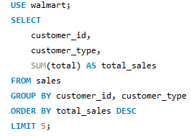
Task 9 – Top 5 Customers by Sales Volume
Result
SQL Query
BUSINESS PROBLEM
customer_id | customer_type | total_sales
8 | Normal | 15357
3 | Member | 13889
2 | Member | 12782
15 | Normal | 12501
11 | Member | 12228
Walmart wants to identify the top 5 customers who generated the highest revenue, so they can be rewarded with loyalty benefits or exclusive offers.
OBJECTIVE
Find the top 5 customers based on total sales volume.
Insight
The top 5 customers contribute a disproportionately high share of total revenue.
A mix of both Members and Normal customers appear in the top list.
These customers should be rewarded with loyalty benefits to encourage repeat purchases.
Approach
Grouped transactions by customer ID, summed total sales, and ranked customers by revenue. Selected the top 5.

Slide 14
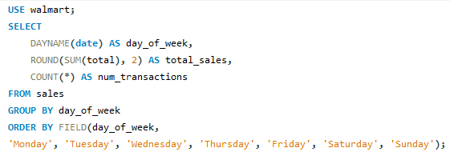
Task 10 – Sales Trends by Day of the Week
BUSINESS PROBLEM
Result
SQL Query
Walmart wants to identify which day of the week generates the highest sales. This helps in workforce planning, inventory management, and designing promotions for peak sales days.
OBJECTIVE
Analyze sales patterns across weekdays and find the best-performing day.
Day_of_week | Total_sales | Num_transactions
NULL | 187611 | 587
Monday | 13821 | 47
Tuesday | 29125 | 80
Wednesday | 14455 | 50
Thursday | 14122 | 52
Friday | 17454 | 53
Saturday | 20891 | 56
Sunday | 25486 | 75
Insight
Saturday shows the highest sales, indicating weekends drive maximum revenue.
Weekdays (esp. Tue–Thu) show relatively lower sales, suggesting promotions can be targeted midweek.
Approach
Grouped sales by day of the week and summed totals to identify the peak sales day.

Slide 15

THANKYOU

